Slide 1
Case Study
Traffic Jam severity Due to Accident

Slide 2
About Data
Data Indicates Traffic Severity in US post Accident, 1 being lowest sever and 4 is the highest.
Data has around 49 columns including target variable.
Data contains numeric columns (Humidity), categorical columns(ex: city), boolean columns(accident side), date columns (ex: start date, end date) and text column(description).
Problem Sizing:
An unforeseen incident on the road has led to an unexpected obstacle—road closure, resulting in a traffic jam that forces people to endure extended hours of travel, causing significant fuel wastage, affecting work hours in the area, and contributing to noise pollution. Anticipating traffic jams in advance enables the state to gain a better understanding of the demand for resources (such as traffic management) and allows for timely notifications to encourage people to consider alternative routes, thereby minimizing the severity of the situation.

Slide 3
Approach:
Treat problem as multiclass classification. Start with the benchmarking model with mandatory step for modeling. Then Improve model with Feature Engineering.
Solution Steps:
Check for Class Imbalance
Missing Value, Constant value, Duplicate Value handling
Benchmarking model
EDA and Feature Engineering
text based feature engineering
Final Model

Slide 4
Evaluation
Objective Function:
- mlogloss
- merror
Offline Evaluation:
Balanced classification accuracy
Confusion metrics
F1-score
Online Evaluation:
Reduction in avg delay after accident

Slide 5
Check for Class Imbalace
Data is Highly Imbalanced with following proportions.
Class | Percentage
1 | 0.83%
2 | 67.43%
3 | 28.43%
4 | 3.2%

Slide 6
Missing value Imputation
Remove fields with more than 50% missing value
Field Name | Missing percentage
End_lat | 70.45%
Enf_lng | 70.45%
Number | 64.40%
Wind_Chill(F) | 53.17%
Precipitation(in) | 57.67%

Slide 7
Constant Value:
Country and Turning_Loop has constant value for entire dataset and not capable of predicting target variable.
However, we can remove columns with constant value for most of the records (> 97%) but since data is highly imbalance and tree models are capable of handling imbalance data they are not removed.

Slide 8
Data Consistency:
Dates are in different timezones, US operates on different time zone and based on US state open source data, verified that date columns indicates local timezone.

Slide 9
Benchmark Model: Introduction
Benchmark model can be heuristic or model without any feature engineering and EDA. It’ll help us to evaluate performance enhancement due to feature engineering and feature selection.
Benchmark model should have better accuracy than random prediction or majority class prediction.

Slide 10
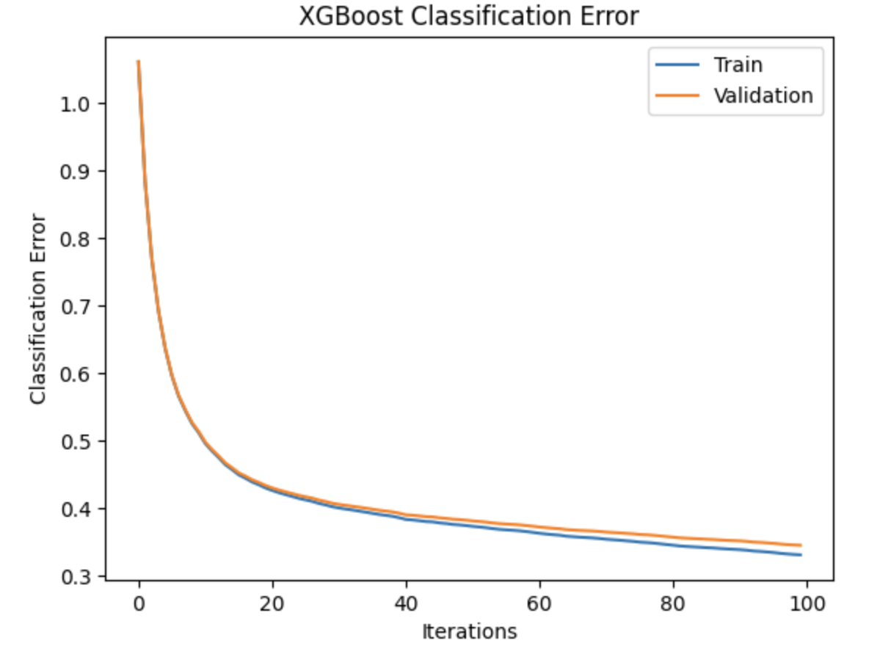
Benchmark Model: Performance

Slide 11
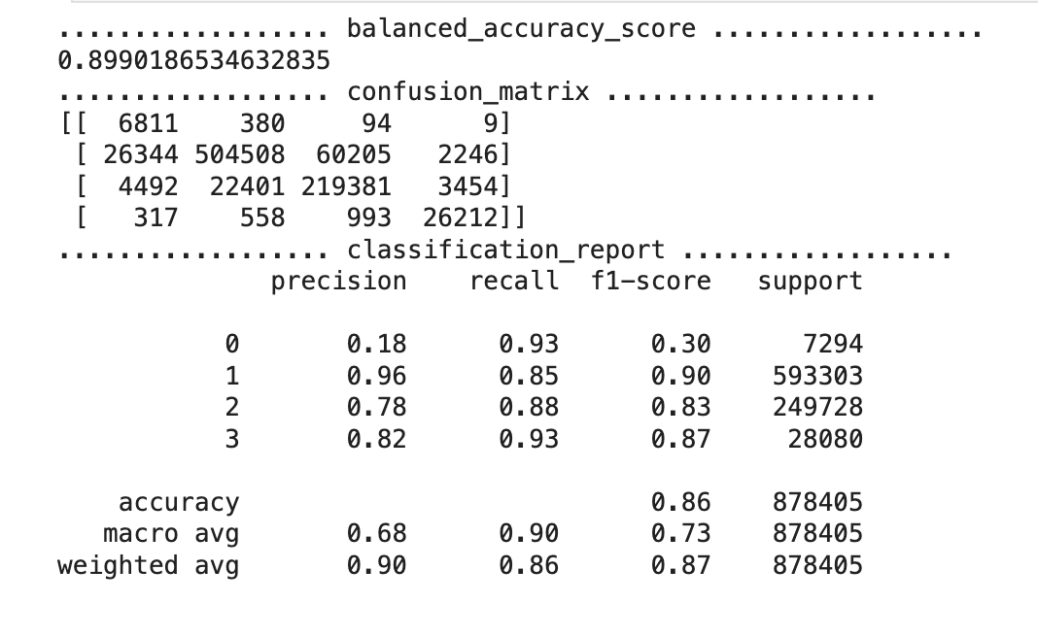
Benchmark Model: Performance

Slide 12
Feature Engineering: Handle date columns
Data columns gives temporal attributes like hour, weekday which help understand pattern of severity based on peak hours, office hours and weekdays and weekends. So hour and weekday are parsed from dates and considered as separate columns.

Slide 13
Feature Engineering: Geometric category
S2ID10, S2ID11 and S2ID12 are computed from startlat and start_lng. These provides locality categories of different size.

Slide 14
EDA: Understand Accident pattern
These dataset is for accidents and density of column value helps with accident states, these helps to identify most accident prune regions, time and days.

Slide 15
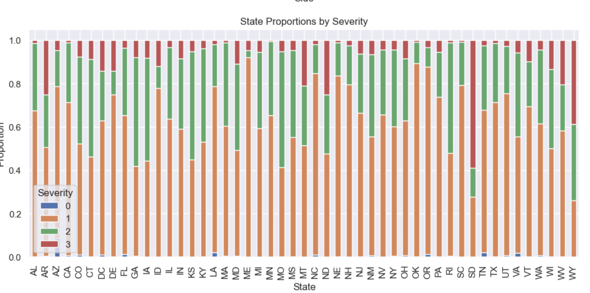
EDA: State wise Accident
Data Suggest that CA, TX and NC has highest accident when comes to absolute number.
But Traffic severity proportion is highest for: SD, WY and ND

Slide 16
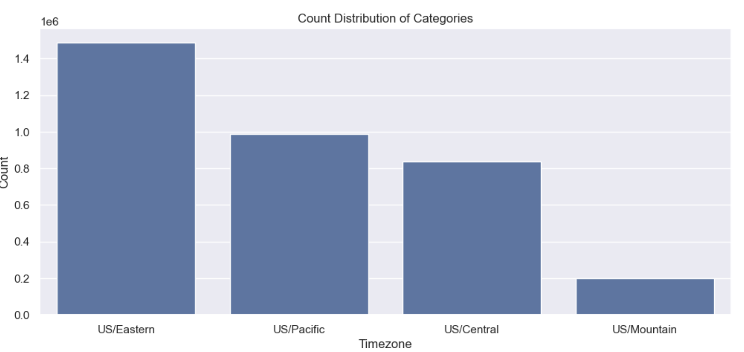
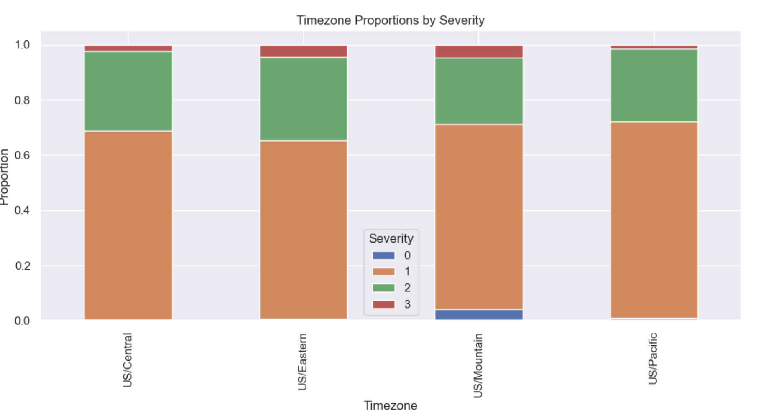
EDA: TimeZone

Slide 17
EDA:
Please follow notebook, for other columns which provide pattern of severity and density distribution.

Slide 18
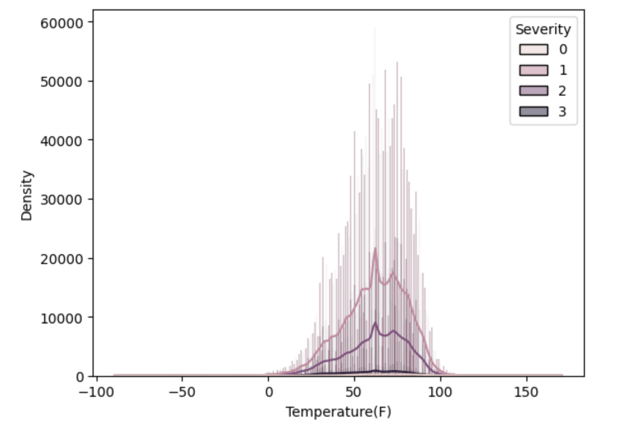
EDA: Severity Distribution Temperature

Slide 19
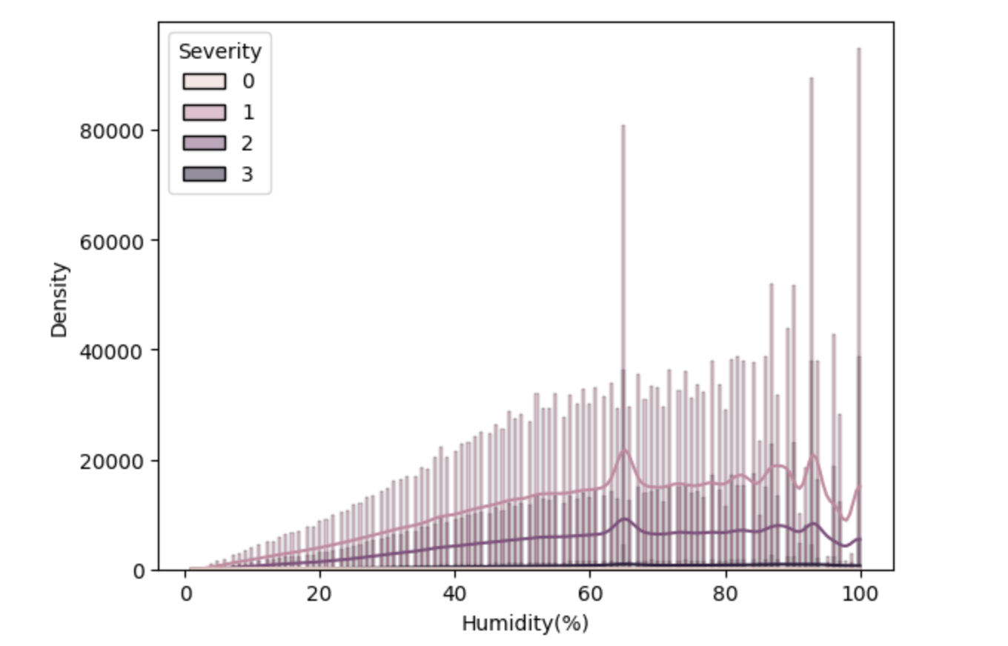
EDA: Severity Distribution Humidity

Slide 20
Feature Engineering: Remove correlated feature
After we add all engineered feature, we expect our features to independent hence correlated features are identified and remove.
We found hour computed from start date and weather date correlated hence one of them removed.

Slide 21
Feature Engineering: Text feature
TFIDF vector computed for top 30 words after basics text processing like stopword removal and lemmitization.
Nltk (as it provided better speed than spacy) used for text cleaning and sklearn for TFIDF vector

Slide 22
Outlier Detection
Column | Number of Outliers
TMC | 373200
Distance(mi) | 746426
Temperature(F) | 26158
Humidity(%) | 0
Visibility(mi) | 777062
Wind_Speed(mph) | 94375

Slide 23
Outlier Treatment
outlier are Kept as they are more than minority class samples even though tree based model are impacted by outliers but in later version impact of outlier across different class should be analyzed and handled.

Slide 24
Final Model
As basic model perform and fit well (Does not overfit) on xgboost with considerable parameters. Final model is also Xgboost classifier model.
Also, Tree base model helps with imbalance data and feature selection and saves considerable feature engineering effort.

Slide 25
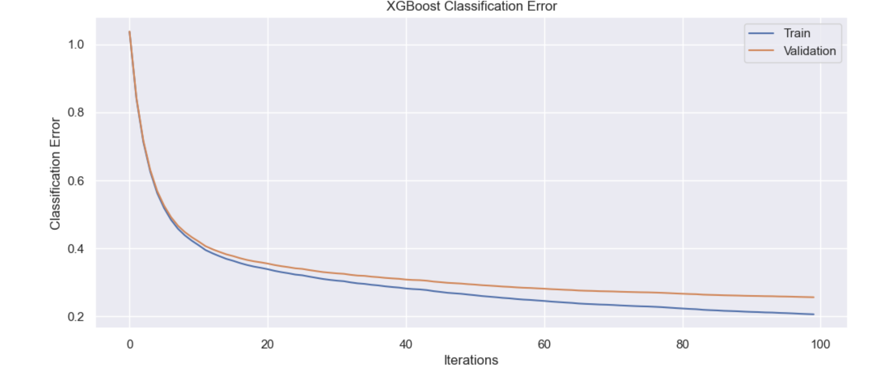
Final model evaluation

Slide 26
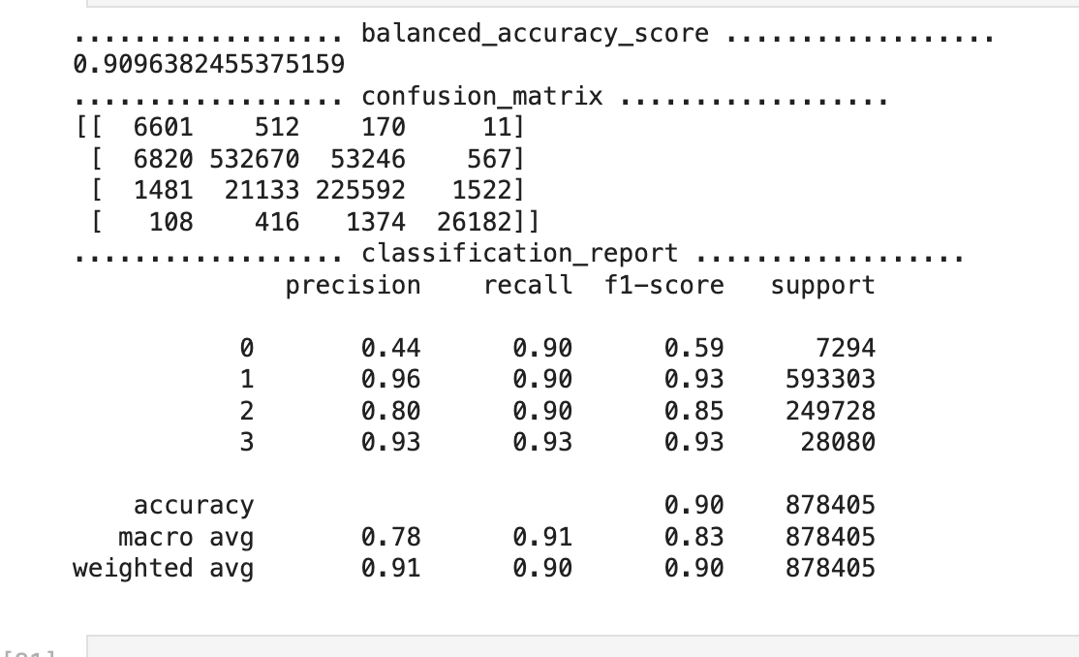
Final model evaluation

Slide 27
Next Steps:
Deployment Pipeline for online prediction as this is real time prediction use case.
Although Tree based model performed well on dataset following should be consider for next iteration
Randomized search CV for hyper parameter tuning
Use advance embeddings for description as it has good amount of feature importance.
USe Neural network or more complex model.

